Slide 1
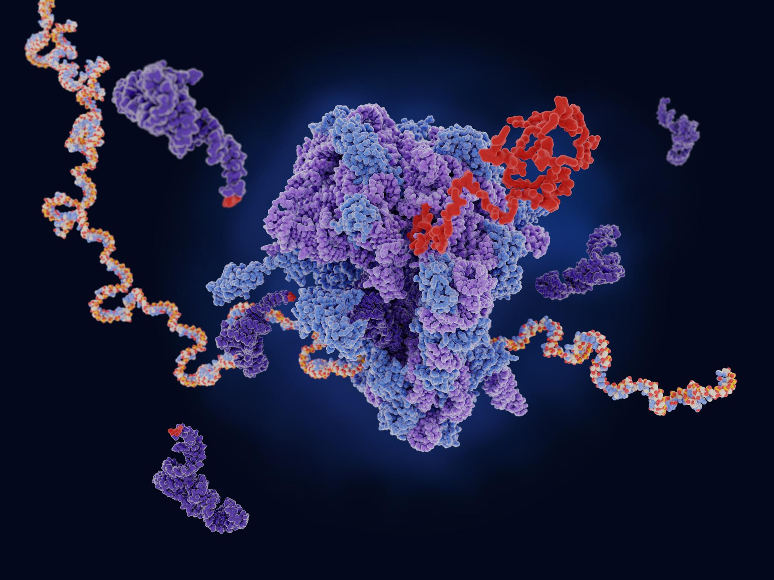

Utilizing Machine Learning for Colon Cancer Staging, Classification, Diagnosis, and Prognosis Prediction
Presented by
Idahosa Clinton
https://jcsmr.anu.edu.au/research/centres/sdcri
https://builtin.com/artificial-intelligence/machine-learning-examples-applications

Slide 2




Team (OncoML)
Sanzida Akhter Anee
MS, Bioinformatics, Independent University of Bangladesh, Bangladesh
Dr. Clinton U Idahosa
MB;BS University of Ibadan, Nigeria.
Stephie Raveloson, M.Sc.
University of Antananarivo, Madagascar
Oluwatosin Owolabi
B.Sc. Biochemistry, University of Ibadan, Nigeria.

Slide 3
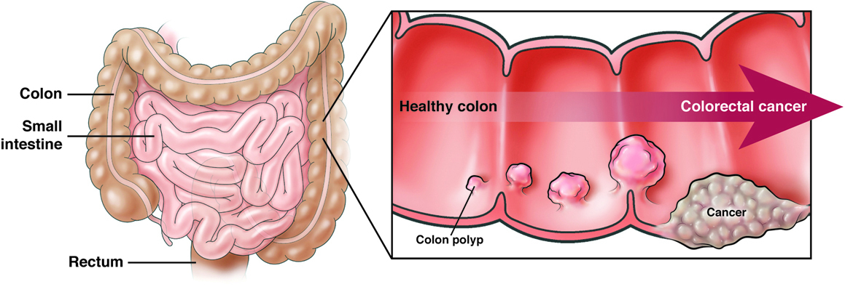
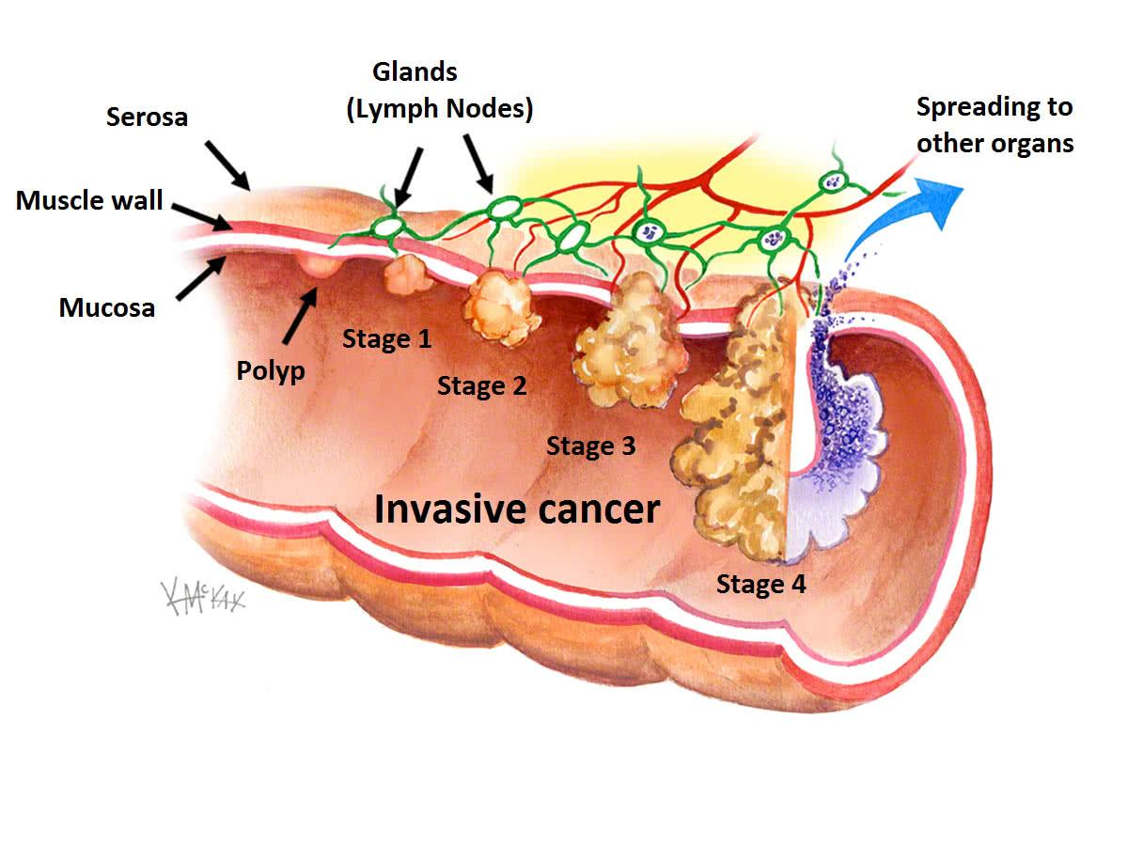
Introduction
https://patient.gastro.org/colorectal-cancer-crc/
Problem
Lymph node involvement
Tumor heterogeneity
Metastasis
Post-surgical recurrence risk
Over /under staging
https://www.baysidecolorectal.com.au/colon-and-rectal-cancer/

Slide 4
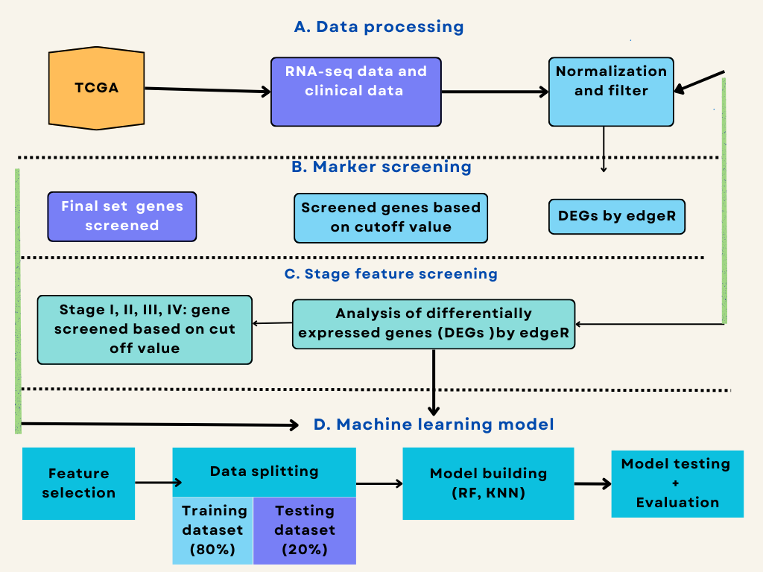

Slide 5
Expected results
Improved accuracy in staging and diagnosis
Random forest best perform colon and cancer staging diagnosis
Accuracy of colon diagnosis >98% [3]
Predicting recurrence risk and survival
Predict recurrence risk (gene expression profiles) stage II and III [4]
Identify biomarker
Colon cancer prognosis associated genes
ML screens new biomarker genes which enhances cancer treatment and targeted therapies.
Enhanced ML model provides accurate diagnostic cancer staging.

Slide 6
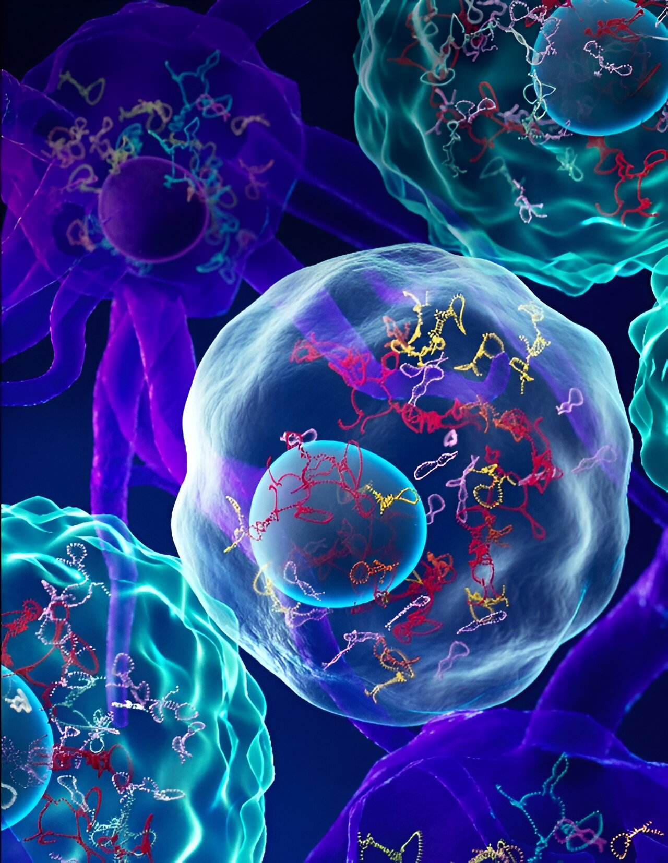
Thank You
Source: google.com

Slide 7
References
Ness, R. M., Llor, X., Abbass, M. A., Bishu, S., Chen, C. T., Cooper, G., ... & Sambandam, V. (2024). NCCN Guidelines® Insights: Colorectal Cancer Screening, Version 1.2024: Featured Updates to the NCCN Guidelines. Journal of the National Comprehensive Cancer Network, 22(7), 438-446.
Colorectal Cancer Early Detection, Diagnosis, and Staging (2024). American Cancer Society. https://www.cancer.org/cancer/types/colon-rectal-cancer.html
Su, Y., Tian, X., Gao, R., Guo, W., Chen, C., Chen, C., ... & Lv, X. (2022). Colon cancer diagnosis and staging classification based on machine learning and bioinformatics analysis. Computers in biology and medicine, 145, 105409.
Jiang, D., Liao, J., Duan, H., Wu, Q., Owen, G., Shu, C., ... & Wang, Z. (2020). A machine learning-based prognostic predictor for stage III colon cancer. Scientific reports, 10(1), 10333.
Guinney, J., Dienstmann, R., Wang, X., De Reynies, A., Schlicker, A., Soneson, C., ... & Tejpar, S. (2015). The consensus molecular subtypes of colorectal cancer. Nature medicine, 21(11), 1350-1356.

